Slide 1

CHATA – A Chat Application
October 2021 – Radu Seitan

Slide 2
application Overview
The project aims to provide the user with access to a real-time messaging application.
Before Login:
The user has to first register his account by email validation
Once registered, the user can log in
After login:
The users can create group chats and add other users to them.
Each member of a group chat has a role: owner and simple member. The owner is the only one who can add other users to the group chat.
The users can also send direct messages to one another.
Any user can be part of multiple group chats at once.

Slide 3
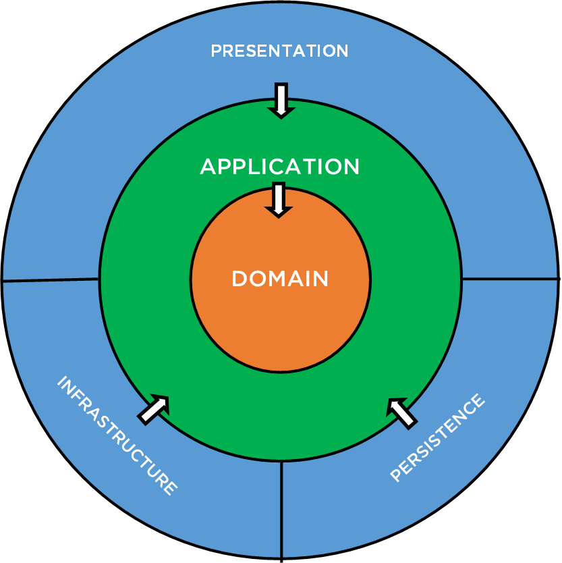
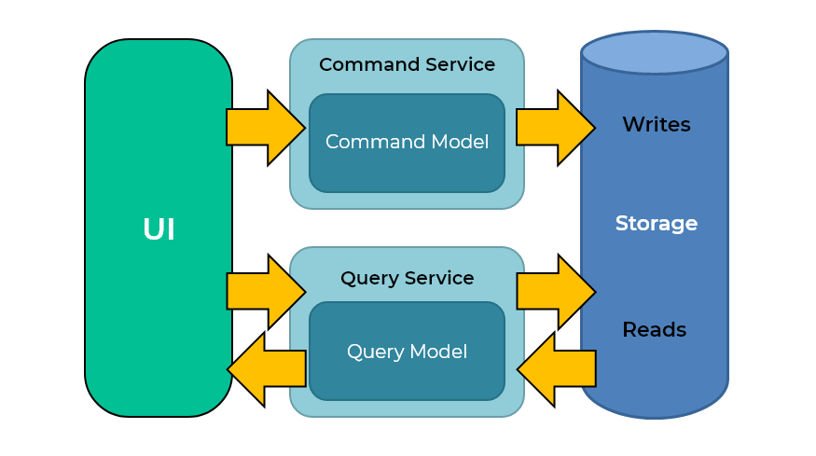









Technology stack
Back-end:
Clean Architecture with CQRS
ASP.NET Core 5.0
Entity Framework Core
Microsoft SQL Server
Front-end:
React.js
Material-UI
Authorization and Authentication:
Auth0
Real-Time Communication:
SignalR
Deploy:
Azure
Documentation:
Swagger

Slide 4
Project Demo

Slide 5
DISCLAIMER
This document has been prepared by Amdaris for the sole use of the recipient. The information contained in this documentation is proprietary and confidential to Amdaris and should be kept confidential and not disclosed by the recipient to any other person unless such person has a need to know such information in order to evaluate the contents of this document.
Amdaris has prepared this document in good faith based on the information made available by the recipient to Amdaris. Amdaris reserves the right to make amendments and to correct any errors that are identified. This document is provided to the recipient subject to contract. Nothing in this document or in any related correspondence, discussions or other materials shall be construed as the basis of any contract or a representation which may be relied upon by the recipient unless agreed by Amdaris in the context of a legally binding agreement. No warranty, assurance or undertaking (express or implied) is or will be made, and no responsibility or liability is or will be accepted by Amdaris or any persons employed or engaged by Amdaris in relation to the adequacy, accuracy, completeness or reasonableness of the contents of this document, or of any other information (whether written or oral), notice or document supplied or otherwise made available to the receipt and, to the maximum extent permitted by applicable law, all and any such responsibility and liability is expressly disclaimed.
The following notice applies to this document and should be reproduced by the recipient on any copies which have been made in accordance with this notice.

